Slide 1


NEXT GEN EMPLOYABILITY PROGRAM
CREATING A FUTURE-READY WORKFORCE
Student Name :
Vansh Sharma
Student ID :
STU61ee773531bb61643018037
Mobile No:
+91 6395863005
Mail ID:
thevanshsharma001@gmail.com
College Name :
KIET Group of Institutions

Slide 2
CAPSTONE PROJECT SHOWCASE
Project Title
Power BI Enabled Comprehensive Analysis on Unicorn Businesses
Abstract | Problem Statement | Project Overview | Proposed Solution | Technology Used | Modelling & Results | Conclusion | Q&A

Slide 3
Abstract
1
Analyzing unicorn companies' key metrics using Power BI for comprehensive insights.
2
Focus on current valuation, funding, country of origin, industry, investors, and founding years.

Slide 4


Problem Statement
Which unicorn companies have had the biggest return on investment?
How long does it usually take for a company to become a unicorn? Has it always been this way?
Which countries have the most unicorns? Are there any cities that appear to be industry hubs?
Which investors have funded the most unicorns?

Slide 5

Project Overview
Data Collection, Cleaning, and Preprocessing: Gathering and refining data on unicorn companies for analysis.
DAX Functions and Basic Visualizations: Using Data Analysis Expressions and foundational visualizations in Power BI for initial insights.
Analysis/Visualizations: Conducting in-depth analysis and creating advanced visualizations to explore trends and patterns.
Formatting and Testing: Refining visualizations for clarity and accuracy and testing for data integrity.
Storytelling, Sharing: Presenting findings in a compelling narrative and sharing reports for stakeholder understanding and decision-making.

Slide 6
Proposed Solution
Which unicorn companies have had the biggest return on investment? => For this problem, I used a matrix to show the ROI for every company in decreasing order. So, we can see the company with biggest ROI on top of the matrix.
How long does it usually take for a company to become a unicorn? Has it always been this way? => For this problem, I used a card which shows the number of years it took for the selected company to become a unicorn business.
Which countries have the most unicorns? Are there any cities that appear to be industry hubs? => For this problem, I used a map and a table which shows the number of unicorns in each country.
Which investors have funded the most unicorns? => For this problem, I used a Stacked Bar chart which shows the number of companies in which each investor invested. It shows the data in decreasing order, so we can find the top investors on the top of the bar chart.
How many companies became a unicorn in a particular year since 2015? => For this problem, I used a Stacked Column chart to show the number of unicorn companies formed in a particular year since 2015.

Slide 7
Technology used
Power BI Power BI's capabilities are instrumental in creating insightful visualizations and reports.

Slide 8
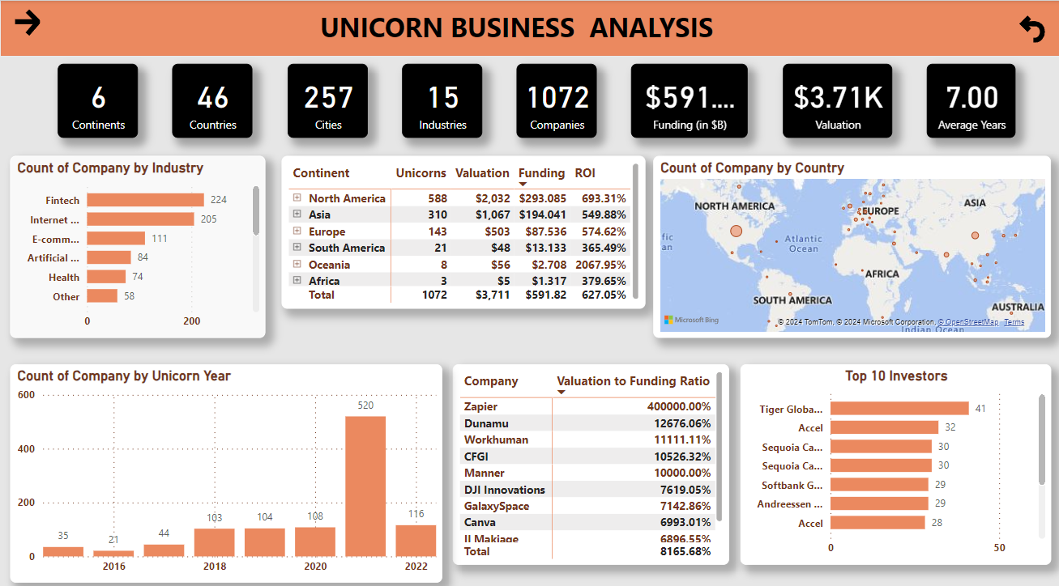
Modelling & Result

Slide 9
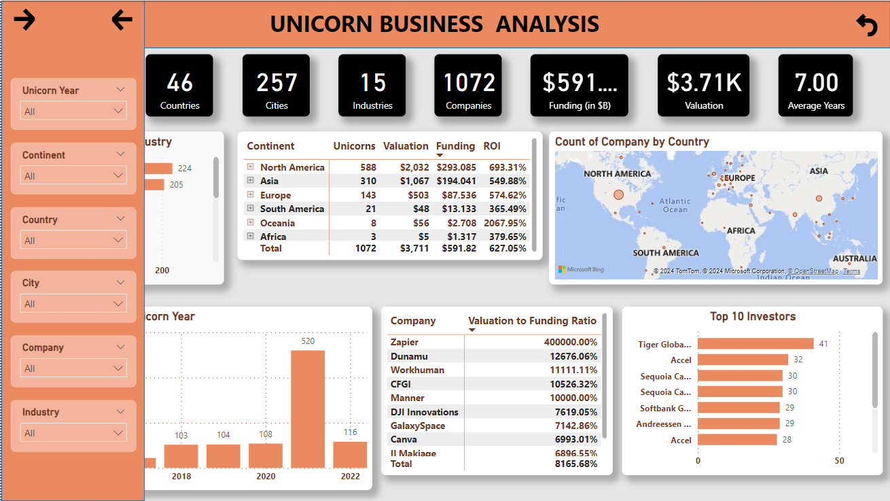
Modelling & Result
In this dashboard, on the top left corner, I used a right arrow button to display the filter panel and a left arrow button to hide it again and show the dashboard with applied filters.
And, on the top right corner I used a reset button to nullify all the filters and see the dashboard in its original state.

Slide 10
Modelling & Result
On the top of the project, I used some cards to show some important details
about a particular unicorn company. These details are:-
Continents
Countries
Cities
Industries
Companies
Funding
Valuation
Average Years (Number of years for a company to become a unicorn)

Slide 11

Conclusion
In conclusion, this project provides a detailed and insightful analysis of unicorn companies, leveraging Power BI to uncover important details about the unicorn companies.

Slide 12


Notes:
Thank You !!

